Slide 1
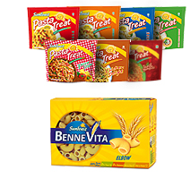


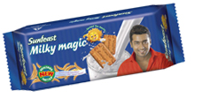

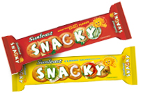


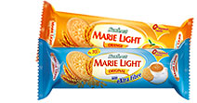







Slide 2

ITC LIMITED
ONE OF THE MOST VALUABLE CORPORATION

Slide 3
ITC- PROFILE
ITC IS AN OUTSTANDING MARKETLEADER IN ITS TRADITIONAL BUSINESSES OF CIGARETTES , HOTELS , PAPERBOARD, PACKAGING AND AGRI-EXPORTS.
IT IS ALSO GAINING MARKET SHARE IN FOOD AND PACKAGED PRODUCTS, GREETING CARDS AND BRAND APPARELS.

Slide 4
ITC SUNFEAST- ENTRY
CARRIED A MARKET RESEARCH BEFORE ENTERING WHICH SHOWED:-
EXISTED A Rs.4000 CRORE BISCUIT MARKET IN INDIA.
ONLY 6% IS PACKAGED.
12-14% YEARLYGROWTH IN BISCUIT SEGMENT
S.

Slide 5
BISCUIT CONSUMPTION IN INDIA

Slide 6
ITC SUNFEAST - ENTRY
FOUND LACUNAS WHICH CAN BE FILLED UP
CRAVING FOR NEW TASTE AMONG CONSUMER
ITC LAUNCHED BISCUITS OF INTERNATIONAL QUALITY UNDER THE SUNFEAST RANGE ON 28th July 2003.

Slide 7
ITC SUNFEAST- A SUCCESS STORY
ITC CAPTURED A MARKET SHARE OF 7% (VALUE).
IN JUST THE SPAN OF 3 YEAR OF TIME.

Slide 8
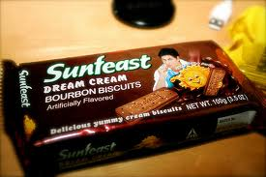
SUNFEAST- PRODUCT RANGE
STUCK TO FAVOURITES LIKE GLUCOSE, MARIE AND BOURBON.

Slide 9

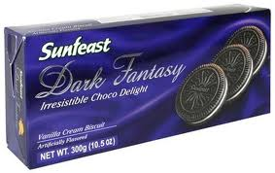
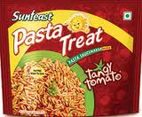
ITC KEPT INNOVATING AND PROVIDED DISTINCTIVE PRODUCTS
Diet Flaxseed Biscuits
Pasta
Chocolate Biscuit

Slide 10
SUNFEAT- PROMOTION
ADVERTISEMENTS TARGETING(ANNUAL ADVERTISING BUDGET OF ITC BISCUIT SEGMENT IS 115-120 CRORES)
MOTHERS ( THRU AWARENESS ADS)
CHILDREN ( THRU ADS ON CARTOON CHANNELS AND PROMOTIONAL GIFTS)
TEENAGERS( SUNFEAST OPEN)
GENERAL PUBLIC( SHAHRUKH KHAN, SURYA, SANIA MIRZA)

Slide 11
SUNFEAST- PRICING
TWO PRONGED STRATEGY:-
PLAYING WITH VOLUMES AND LOW MARGINS IN THEIR GLUCOSE AND MARIE SEGMENT.
WHILE PLAYING WITH HIGH MARGINS IN CREAM VARIANT.

Slide 12
SUNFEAST- DISTRIBUTION
SUNFEAST IS NOW AVAILABLE IN 1.8 MILLION
STORE OF INDIA AS COMPARED TO BRITANNIA
AND PARLE (3.3 & 1.5 MILLION RESP.)
IT USED ITS EXISTING DISTRIBUTION SYSTEM.
ALSO LOOKED AT GROCERY STORE AND OTHER RETAIL FORMAT.

Slide 13
SUNFEAST EXISTING COMPETITION AND MARKET SHARE

Slide 14
SUNFEAST- NEW COMPETITORS
GlaxoSmithKline Consumer Healthcare: Junior Horlicks Biscuits-toddler biscuit category.
PepsiCo India Launched biscuit brand Aliva, it will be produced by food division Frito Lay India.
United Biscuits (UK), world’s third largest biscuit company, is set to enter India market.
Shakti Bhog plans to enter biscuits segment.

Slide 15
EFFORTS OF GROUP NO.-4
GROUP MEMBERS:-
TEAM LEADER :DARNALA SURENDRA
TEAM MEMBERS :GANESHULA NAVEEN

